Slide 1
Giving First Aid: CPR

Slide 2
Things to Remember!
Update your Table of Contents.
-Date: 10/3/18
-Title of Assignment: First Aid-CPR Notes
-Standard: 7.1.S
-Page #:
Vocabulary Index (Include page #): Words to be included today: first aid, cardiopulmonary resuscitation (CPR), rescue breathing, and Automated External Defibrillators (AED’s).
DO NOT copy what is in RED bold, only BLACK!!
Anything in GREEN is a question for you to answer only.

Slide 3
First Aid-CPR (CN)
Immediate care given to someone who becomes injured or ill until regular medical care can be provided.
First-aid procedure to restore breathing and circulation.
First Aid
cardiopulmonary resuscitation (CPR)

Slide 4
rescue breathing
Automated External Defibrillators (AED’s)
First-aid procedure where someone forces air into the lungs of a person who cannot breathe on his her own.
This electronic device sends a quick jolt of electricity to the heart through the chest to make the heart start beating again.

Slide 5
First Aid
Proper training is needed to give first aid. In an emergency, the American Red Cross suggests the following strategy: Check-Call-Care
Check the scene and the victim. Make sure the area is safe for you and the victim. Move the victim only if he or she is in danger.
Call for help. Call 911 or the local EMS number. EMS stands for “emergency medical service.”
Care for the person until help arrives. Use the first-aid techniques in this lesson to treat the victim until help arrives.

Slide 6
The Steps of CPR
#1 Check Breathing:
-Look inside the victim’s mouth. If you can see anything blocking the airway, remove it. Gently roll the person onto his/her back. Tilt the head back as you lift up the airway. Look, Listen, and Feel to find out if the victim is breathing. Look for the rise and fall of the chest. Place your ear next to the victim’s mouth and nose and listen for breathing. Feel for the exhaled air on your chest.

Slide 7
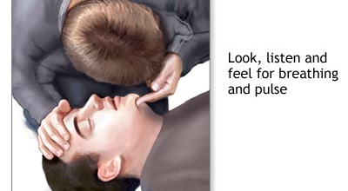
Check Breathing

Slide 8
The Steps of CPR
#2 Rescue Breaths:
Keep the victim’s head and chin in proper position, pinch the person’s nostrils shut.
Place your mouth over the victim’s mouth, forming a seal. Give 2 breaths, each about one second long. The victim’s chest should rise each breath.

Slide 9
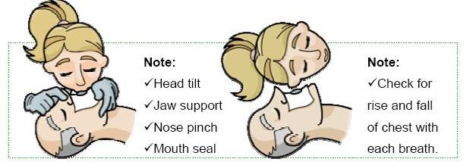
Rescue Breaths
1. Tilt the head
2. Pinch the nose
3. Give 2 Breaths
4. Look at chest

Slide 10
The Steps of CPR
#3 Chest Compressions:
-Immediately after giving 2 rescue breaths, begin chest compressions. Give 2 rescue breaths after 30 chest compressions.

Slide 11
Kneel-Interlock-Compress

Slide 12
First Aid
Adult CPR Video
Checking for Understanding
Why is it important to know first aid and CPR?
Write a sentence and give an example.

