Slide 1
Tobacco: A Harmful Drug
Notes

Slide 2
Things to Remember!
Update your Table of Contents.
-Date: 4/24/19
-Title of Assignment: Tobacco: A Harmful Drug
-Standards: 1.1 .A
-Page #:
Vocabulary Index (Include page #): Words to be included today are nicotine, carbon monoxide, tar, emphysema, addiction, snuff, alveoli and secondhand smoke. DO NOT copy what is in RED bold, only BLACK!!
Anything in GREEN is a question for you to answer only.
*Visit www.glencoe.com to complete online study guides and self assessments.
*Today’s notes and more alcohol related resources can be found at www.alliancefitness24-7.weebly.com

Slide 3
Tobacco: A Harmful Drug (CN)
Nicotine
Carbon Monoxide
Tar
Is a drug that speeds up the heartbeat and affects the central nervous system.
Is a poisonous, odorless gas produced when tobacco burns.
Is a thick, oily, dark liquid that forms when tobacco burns.

Slide 4
Tobacco: A Harmful Drug (CN)
Emphysema
Addiction
Snuff
Is a disease that occurs when the tiny air sacs in the lungs lose their elasticity, or ability to stretch.
Is the body’s physical or mental need for a drug or other substance.
Is finely ground tobacco that is inhaled or held in the mouth or cheeks.

Slide 5
Tobacco: A Harmful Drug (CN)
Alveoli
Secondhand smoke
The tiny air sacs in the lungs.
Is air that has been contaminated by tobacco smoke.

Slide 6
Facts About Tobacco
A single puff of tobacco smoke contains more than 4,000 harmful chemicals!
Most of those chemicals hurt your body’s ability to work properly.
Several of them can cause cancer in people who smoke.
In the United States, more than 400,000 people die every year from smoking-related illnesses.

Slide 7
What’s in Tobacco
Tobacco contains a number of harmful chemicals, such as nicotine.
Tobacco smoke also contains carbon monoxide.
A third substance is tar.
A ton of other deadly substances.

Slide 8
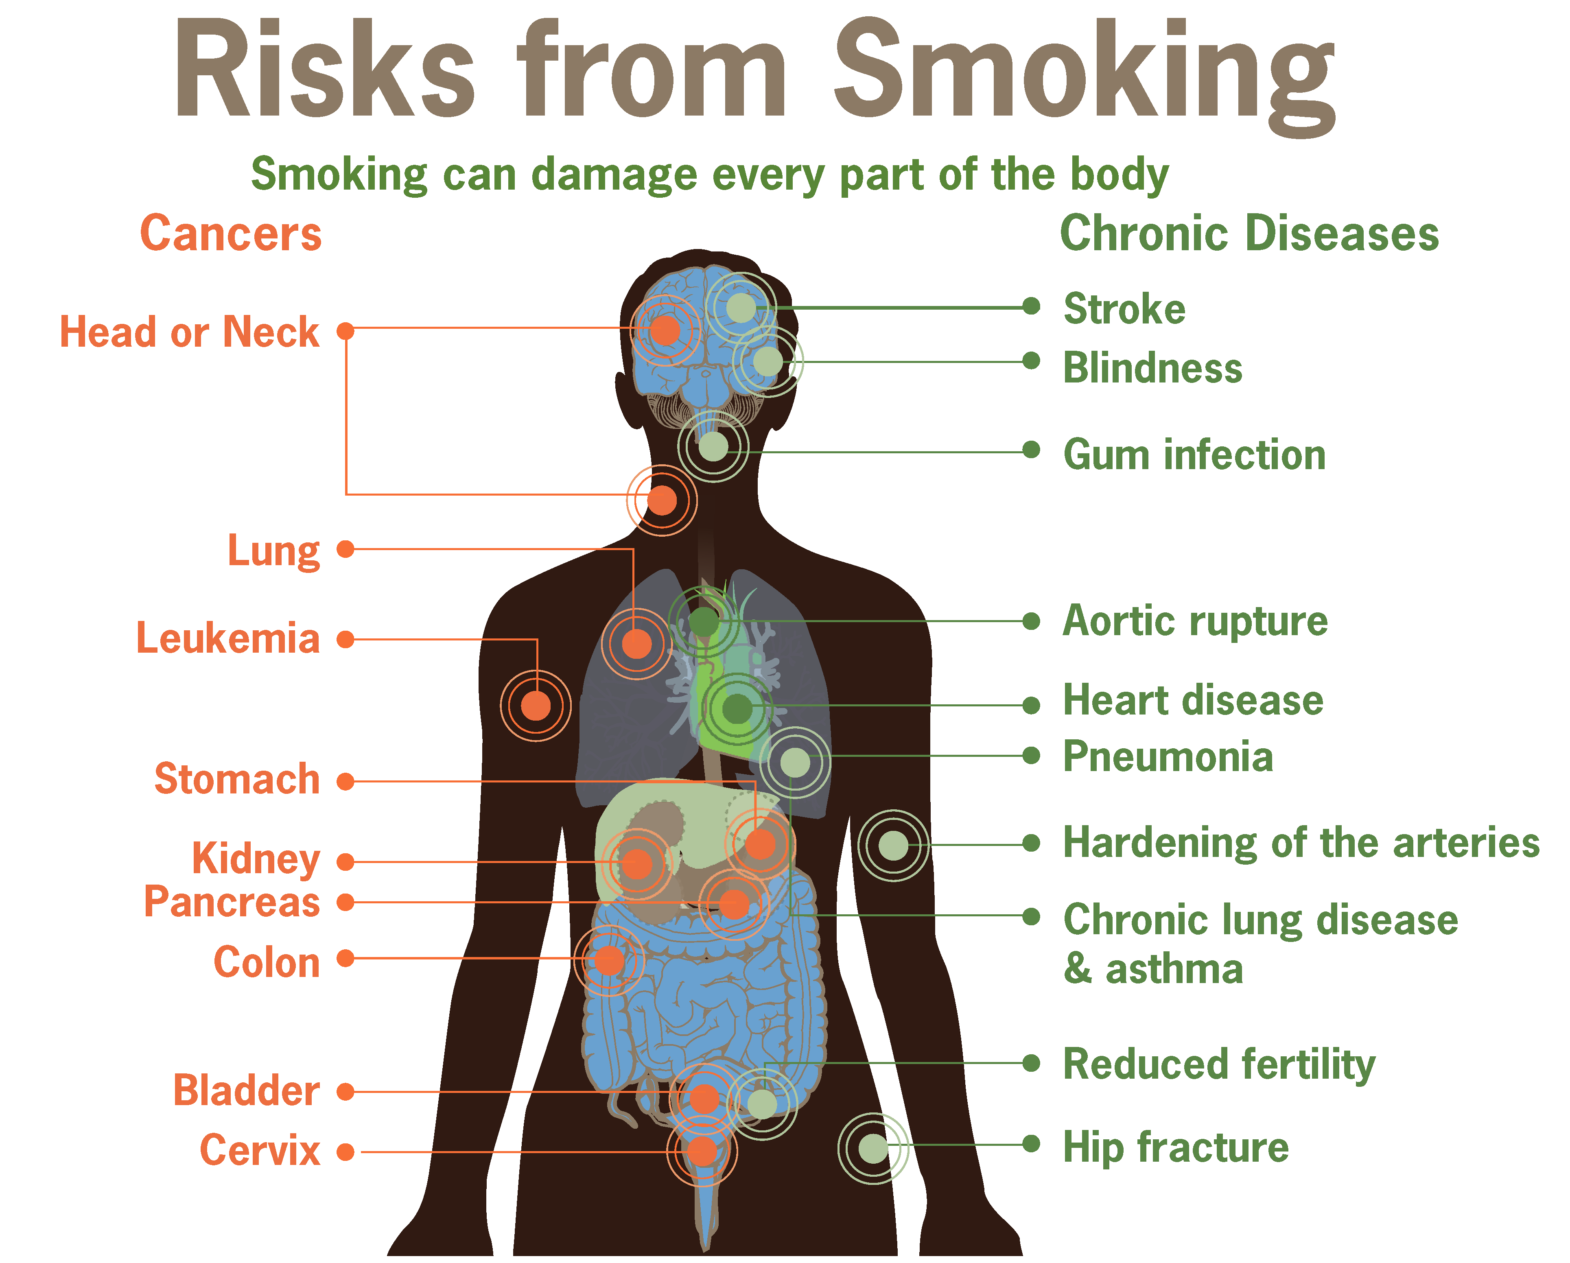

Slide 9
Short-term Effects of Tobacco
Smoking also causes many short-term effects, such as poor lung function. This is why smokers often suffer shortness of breath and nagging coughs.
They often tire quickly during physical activity.
Some other common short-term effects include decreased sense of smell and taste, premature aging of the skin, bad breath, and stained teeth.

Slide 10
Long-term Effects of Tobacco
Long-term, smoking is also a major cause of heart disease, aneurysms, bronchitis, emphysema, and stroke.
It also makes pneumonia and asthma worse. Smoking is linked to about half of the gum disease in the United States, which means more tooth loss and mouth surgery.
Wounds take longer to heal and the immune system may not work as well in people who smoke.
Smoking also damages the arteries. This is why many vascular surgeons refuse to operate on patients with peripheral artery disease (poor blood circulation in the arms and legs) unless they stop smoking.

Slide 11
Second Hand Smoke Can Cause
Ear infections
Asthma attacks
Allergic reactions
Cancer
Smelly clothes
Red, irritated eyes, etc.

Slide 12
How do you quit?
Nicotine Patch
Nicotine Gum
Cold Turkey
Electronic/Water Vapor Cigarette
Wooden Cigarette
Acupuncture
Hypnosis
Hotlines

Slide 13
Relative or Friend
Does anyone here has a family member or friend that smokes tobacco?

Slide 14
Works Cited
http://www.cancer.org/cancer/cancercauses/tobaccocancer/questionsaboutsmokingtobaccoandhealth/questions-about-smoking-tobacco-and-health-effects-of-smoking
Teen Health Course 2. Glencoe McGraw Hill

