Slide 1
Introduction to the “FitnessGram” P.F.T. Assessments

Slide 2
Things to Remember!
Update your Table of Contents.
-Date: 8/15/18
-Title of Assignment: Physical Fitness Testing (PFT)
-Standards: 3.1
-Page #:
Vocabulary Index (Include page #): Words to be included today are: aerobic capacity, abdominal strength & endurance, upper body strength & endurance, body compostion, trunk extensor strength, and flexibility DO NOT copy what is in RED bold, only BLACK!!
Anything in GREEN is a question for you to answer only.

Slide 3
History of the P.F.T.
The statewide physical fitness testing program was first authorized in 1976 and reestablished in 1995 as part of the California Assessment of Academic Achievement Act. In February 1996, the California designated the FITNESSGRAM® as the required physical fitness test that school districts shall administer to California students in grades 5th, 7th and 9th.

Slide 4
FitnessGram
Is the most important assessment of Physical Education
Is a tool used to assess physical fitness and physical activity levels for children
Results must be submitted to the state for all 5th, 7th, & 9th grade students

Slide 5
Vocabulary Words (CN)
Body Composition
Aerobic Capacity
is used to describe the percentages of fat, bone, water and muscle in human bodies
the highest amount of oxygen consumed during maximal exercise in activities that use the large muscle groups in the legs or arms combined

Slide 6
Vocabulary Words (CN)
Abdominal Strength & Endurance
Upper Body Strength & Endurance
the ability of the abdomen muscles to exert force for an extended period
the ability of upper body muscles to exert force for an extended period

Slide 7
Vocabulary Words (CN)
Trunk Extensor Strength
Flexibility
the maximum extension of the lower back muscles to extend the trunk
the ability to perform a maximal stretch without causing injury

Slide 8
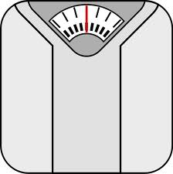
1. Body Composition (f)
Definition: is used to describe the percentages of fat, bone, water and muscle in human bodies
Used to measure:
-height
-weight
-percent body fat

Slide 9
2. Aerobic Capacity (a)
Definition: is the highest amount of oxygen consumed during maximal exercise in activities that use the large muscle groups in the legs or arms combined
Used to measure:
Mile Run

Slide 10
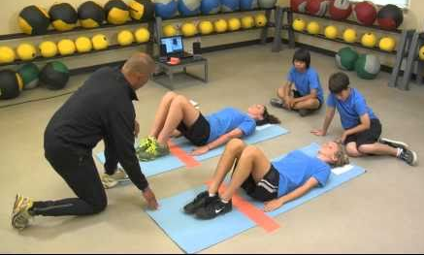
3. Abdominal Strength & Endurance (c)
Definition: is the ability of the abdomen muscles to exert force for an extended period
Used to measure:
Curl-ups/Sit-ups

Slide 11
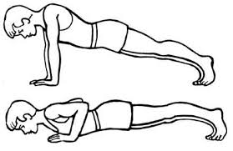
4. Upper Body Strength & Endurance (b)
Definition: is the ability of upper body muscles to exert force for an extended period
Used to measure:
Push-ups

Slide 12
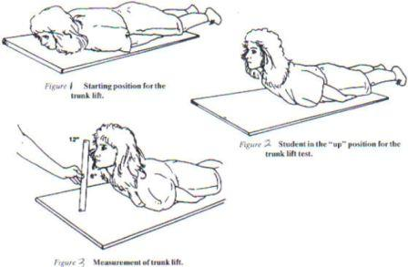
5. Trunk Extensor Strength (d)
Definition: is the maximum extension of the lower back muscles to extend the trunk
Used to measure:
Trunk Lift

Slide 13
6. Flexibility (e)
Definition: the ability to perform a maximal stretch without causing injury
Used to measure:
Shoulder Stretch
-left arm
-right arm

Slide 14
Pair/Share Pre-Quiz
Directions: Write down 1 thru 6 with the person next to you, discuss which fitness test and fitness component belong together. It is okay if you don’t know the correct answer, but make sure to try your best. Be prepared to share with the class.
Fitness Components
Body Composition ___
Aerobic Capacity ___
Abdominal Strength & Endurance ___
Upper Body Strength & Endurance ___
Trunk Extensor Strength ___
Flexibility ___
Fitness Tests
Mile run
Push-Ups
Sit-Ups/Curl-Ups
Trunk Lift
Shoulder Stretch
Height, Weight, & % of body fat

Slide 15
And the Answers are….
Fitness Components
Body Composition f
Aerobic Capacity a
Abdominal Strength & Endurance c
Upper Body Strength & Endurance b
Trunk Extensor Strength d
Flexibility e
Fitness Tests
Mile run
Push-Ups
Sit-Ups/Curl-Ups
Trunk Lift
Shoulder Stretch
Height, Weight, & % of body fat

Slide 16
Overview of FitnessGram
Overview of FitnessGram (7:36)
https://www.youtube.com/watch?v=nJWCXmt8kvs

