Slide 1
Safety at Home

Slide 2
Things to Remember!
Update your Table of Contents.
-Date: 9/4/18
-Title of Assignment: Safety at Home Notes
-Standards: 1.13.S
-Page #:
Vocabulary Index (Include page #): Words to be included today smoke alarm, fire extinguisher, pedestrians, neighborhood watch programs, flammable, and electrical overload.
DO NOT copy what is in RED bold, only BLACK!!
Anything in GREEN is a question for you to answer only.

Slide 3
Safety at Home and Away(CN)
Smoke alarm
Fire extinguisher
Flammable
Electrical overload
A device that makes a warning noise when it senses smoke.
A device that releases chemicals that smother flames.
Able to catch fire easily
A dangerous situation in which too much electric current flows along a single circuit.

Slide 4
Safety at Home
Safety at Home includes:
Fire Safety
Preventing Falls
Poisonous products
Electrical Safety
Gun Safety

Slide 5
Fire Safety
Causes of Fires in the Home:
Careless Cooking
Careless Smoking
Incorrect storage of flammable materials
Damaged electrical systems or electrical overload.
Gas leaks.

Slide 6
Fire Safety Cont. (discuss)
Keep stoves and ovens clean. Keep flammable materials away from burners.
Never let a smoker toss a cigarette into a trash can before making sure it is completely extinguished. You can also remind people not to smoke in bed.
Store matches and lighters out of the reach of children. Never play with matches or lighters. Don’t leave candles burning unattended.

Slide 7
Preventing Falls
Most falls occur in the kitchen, bathroom, or on stairs
Tips for preventing falls:
-clean up spills or wet areas right away
-have a rug or nonskid mat by the shower/tub
-keep stairways lit and clear of objects

Slide 8
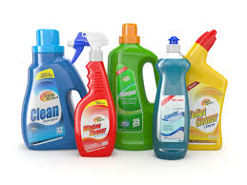
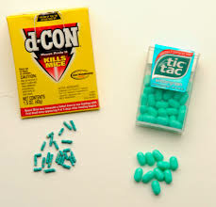
Poisonous Products
Many household products are poisonous
Tips for dealing with Poisonous products:
never call children’s medicine “candy”
Make sure all medicines are secure with caps
Make sure all household products are clearly marked
Keep all poisonous products away from children

Slide 9
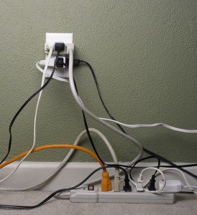
Electrical Safety
Tips for Electrical Safety
Never use an electrical appliance around water
Unplug small appliances that arent being used (such as hair dryer or curling iron)
In homes with small children,
cover unused outlets with
plastic outlet protectors

Slide 10
Gun Safety
Tips for Gun safety:
Always observe gun safety rules
Never touch a gun
If you find a gun, report it to a trusted adult
Never play with a gun, always act as if it loaded
If you ever notice someone with a gun, report it right away

Slide 11
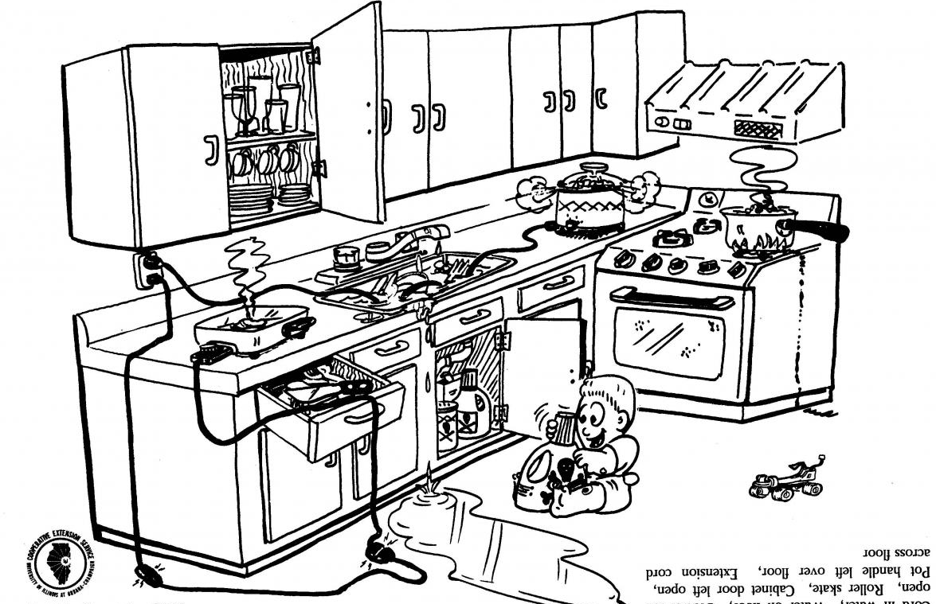
Exit Slip
Analyze the picture below and write down at least 5 things happening that are unsafe.

